Slide 1
Screening Rules for sensors
Yao, Yi-Ting Lin

Slide 2
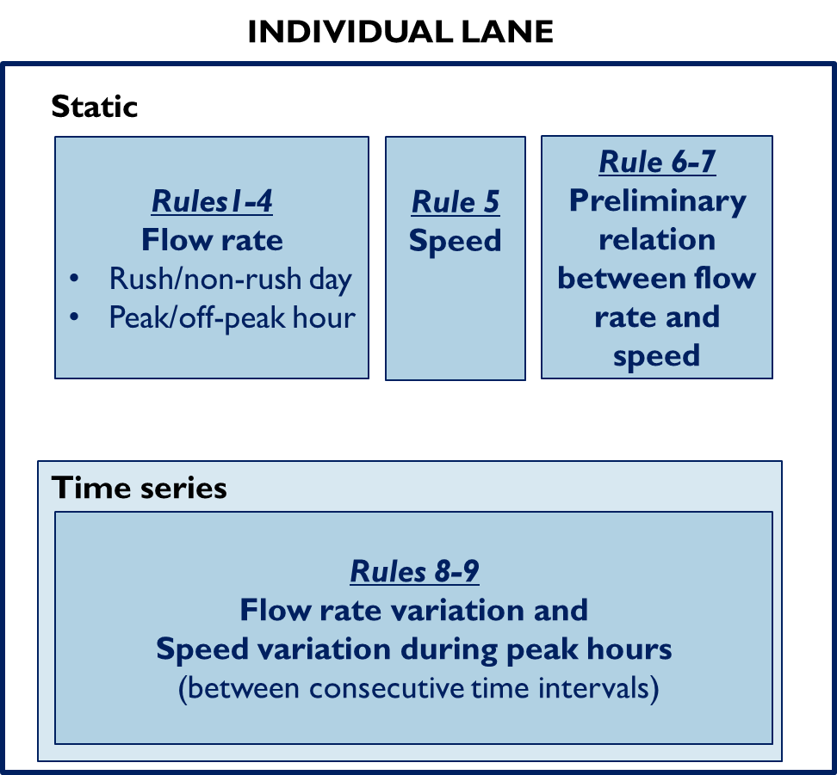
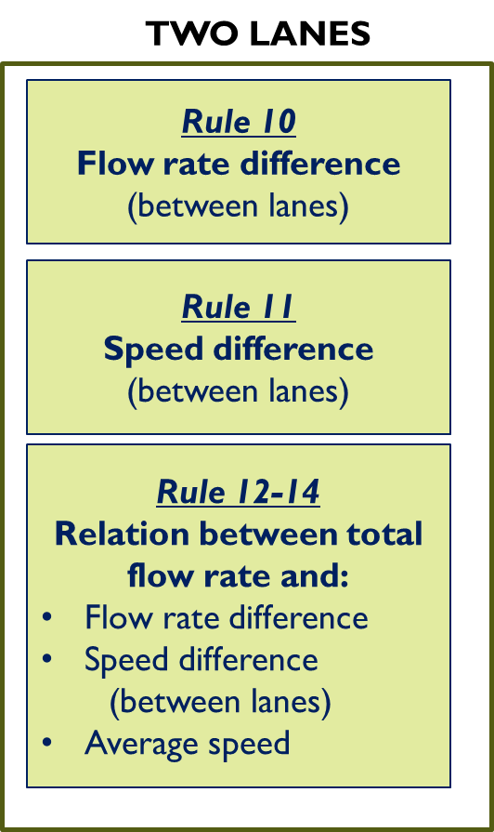
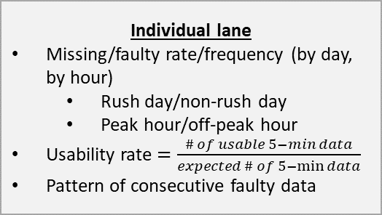
c
Data examination
Examination result analysis
Missing data
Missing rate (data availability)
Missing data pattern/distribution
Individual lane
Missing/faulty rate/frequency (by day, by hour)
Rush day/non-rush day
Peak hour/off-peak hour
Usability rate $=\frac{\# of usable 5−min data}{expected \# of 5−\min{data}}$
Pattern of consecutive faulty data
Screening rules
Screening
Rules
Excluding
faulty data
Speed-Flow rate Relation
Two-lane
Inter-lane performance comparison
Similar performance
Significantly different performance
→ Statistic test
All identified faulty data
Faulty rate
Faulty data pattern/distribution
Output
The sensor is in a good condition and data is reliable
Data is not reliable but can be used for some circumstances
Data is not reliable and sensor calibration might be needed
The sensor is in a bad condition
Check precision (on-site)

Slide 3
For each Screening rule or Speed-flow rate relation, there may be three examination results of each recorded data:
Faulty data
Questionable data
Non-faulty data
→ Questionable data has to be further assessed
Speed-Flow rate Relation

Slide 4
Assess Questionable data
If the recorded data is identified as questionable data
From:
Rule 1 to Rule 4
Check Rule 10
Check Rule 12 to Rule 14
Check Speed-flow rate relation
From:
Rule 5
Check Rule11
Check Rule 12 to Rule 14
Check Speed-flow rate relation
From:
Rule 6 to Rule 9 or Rule 10 to Rule 14
Check Speed-flow rate relation
If it is identified as faulty data or questionable data at the corresponding rules
Considered that questionable data as faulty data
Flow-rate-related rules
Speed-related rules
Involve both speed and
flow rate rules

Slide 5
Screening Rules

Slide 6
Rule summary
INDIVIDUAL LANE
TWO LANES
Static
Rule 10
Flow rate difference
(between lanes)
Rules1-4
Flow rate
Rush/non-rush day
Peak/off-peak hour
Rule 5
Speed
Rule 6-7
Preliminary relation between flow rate and speed
Rule 11
Speed difference
(between lanes)
Rule 12-14
Relation between total flow rate and:
Flow rate difference
Speed difference
(between lanes)
Average speed
Time series
Rules 8-9
Flow rate variation and
Speed variation during peak hours
(between consecutive time intervals)
Notes:
https://safety.fhwa.dot.gov/geometric/pubs/mitigationstrategies/chapter3/3_designspeed.cfm

Slide 7
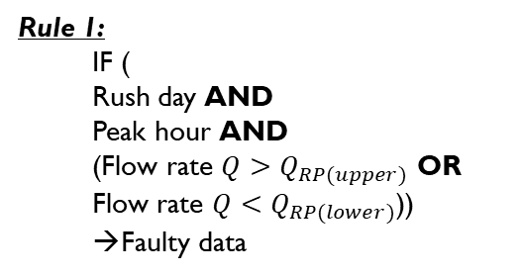
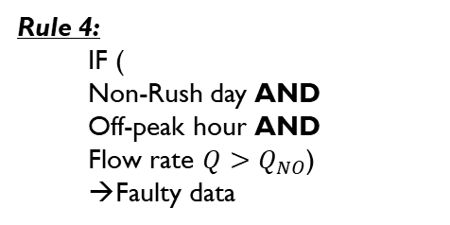
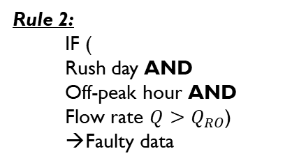
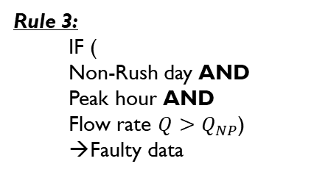
Single Lane-Flow rate
This set of rules examines whether the detected flow rate is within a reasonable range, which varies among days and within one day
Variation between days: Rush day or Non-rush day
Variation within one day: Peak hour or Off-peak hour
Rule1-4
Flow rate
Rush/non-rush day
Peak/ off-peak hour
Rule 1:
IF (
Rush day AND
Peak hour AND
(Flow rate $Q>Q_{RP(upper)}$ OR
Flow rate $Q<Q_{RP(lower)}$))
Faulty data
Rule 2:
IF (
Rush day AND
Off-peak hour AND
Flow rate $Q>Q_{RO}$)
Faulty data
Rule 3:
IF (
Non-Rush day AND
Peak hour AND
Flow rate $Q>Q_{NP}$)
Faulty data
Rule 4:
IF (
Non-Rush day AND
Off-peak hour AND
Flow rate $Q>Q_{NO}$)
Faulty data

Slide 8
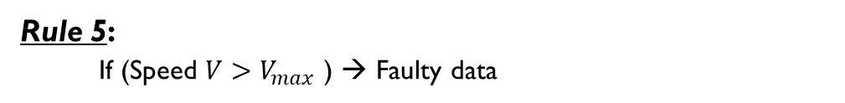
Single Lane-Speed
This rule examines whether the detected speed is within a reasonable range
Data shows no significant difference of maximum speed between:
Peak hour/off peak hour
Rush/non-rush day
Rule 5:
If (Speed $V>V_{max}$ ) → Faulty data
Static
Rules1-4
Flow rate
Rush/non-rush day
Peak/off-peak hour
Rule 5
Speed
Rule 6-7
Preliminary relation between flow rate and speed
Notes:
https://safety.fhwa.dot.gov/geometric/pubs/mitigationstrategies/chapter3/3_designspeed.cfm

Slide 9
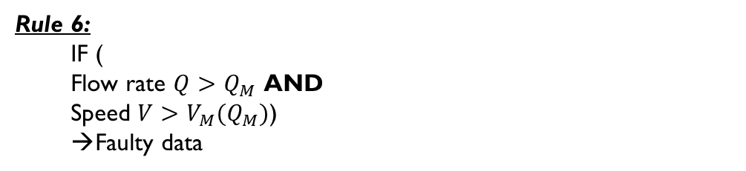
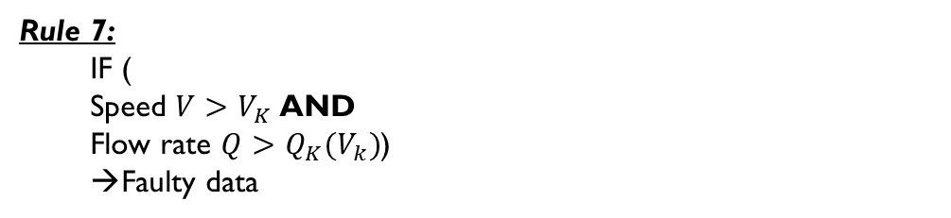
Single Lane-Flow rate + Speed
These rules examine the preliminary relation between flow rate and speed
Whether the detected speed is within a reasonable range when the flow rate is high
Whether the detected flow rate is within a reasonable range when the speed is high
Rule 6:
IF (
Flow rate $Q>Q_{M}$ AND
Speed $V>V_{M}(Q_{M})$)
Faulty data
Static
Rules1-4
Flow rate
Rush/non-rush day
Peak/off-peak hour
Rule 5
Speed
Rule 6-7
Preliminary relation between flow rate and speed
Rule 7:
IF (
Speed $V>V_{K}$ AND
Flow rate $Q>Q_{K}(V_{k})$)
Faulty data
Notes:
https://safety.fhwa.dot.gov/geometric/pubs/mitigationstrategies/chapter3/3_designspeed.cfm

Slide 10
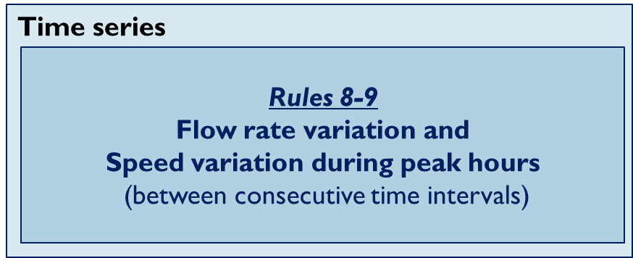
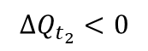
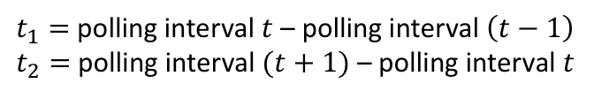
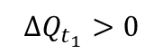
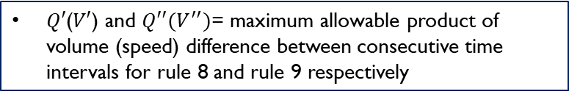
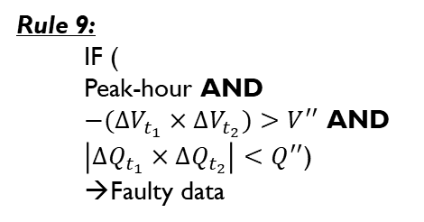
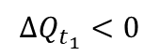
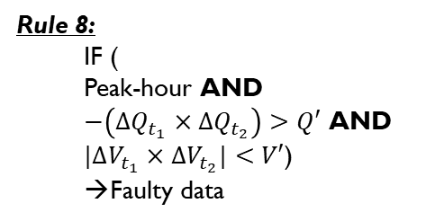
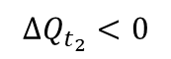
Single Lane-Time series relation
This set of rules identifies abnormal fluctuations of flow rate or speed during the peak hour.
Flow rate (Q)
Opposite trend → faulty
$$∆Q_{t_{1}}>0$$
$$∆Q_{t_{2}}<0$$
Rule 8:
IF (
Peak-hour AND
$−\left(∆Q_{t_{1}}×{∆Q}_{t_{2}}\right)>Q′$ AND
${|∆V}_{t_{1}}×{∆V}_{t_{2}}|<V′$)
Faulty data
Rule 9:
IF (
Peak-hour AND
${−(∆V}_{t_{1}}×{∆V}_{t_{2}})>V^{′′}$ AND
$\left|∆Q_{t_{1}}×{∆Q}_{t_{2}}\right|<Q^{′′}$)
Faulty data
Time interval (t)
t-1
t
t+1
Flow rate (Q)
Same trend → non-faulty
$Q′$($V′$) and $Q′′(V^{′′})$= maximum allowable product of volume (speed) difference between consecutive time intervals for rule 8 and rule 9 respectively
$$∆Q_{t_{1}}<0$$
$$∆Q_{t_{2}}<0$$
$t_{1}=$ polling interval $t$ – polling interval $\left(t−1\right)$
$t_{2}=$ polling interval $(t+1)$ – polling interval $t$
Time interval (t)
t-1
t
t+1

Slide 11
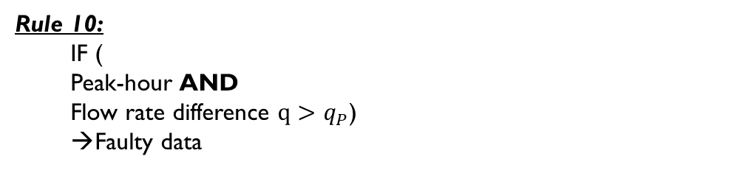
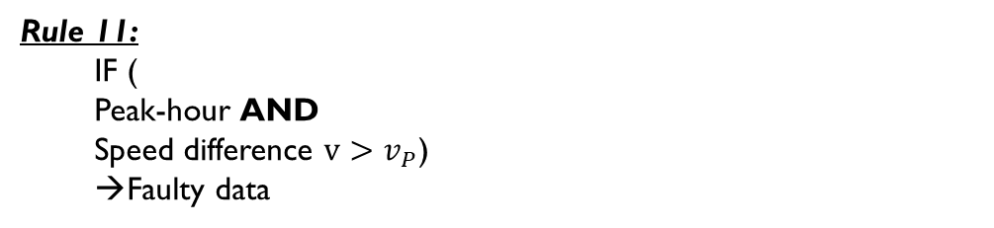
Two Lanes
TWO LANES
This set of rules examines whether the inter-lane volume/speed difference during the peak hour is reasonable
Rule 10
Flow rate difference
(between lanes)
Rule 10:
IF (
Peak-hour AND
Flow rate difference $q>q_{P}$)
Faulty data
Rule 11
Speed difference
(between lanes)
Rule 12-14
Relation between total flow rate and:
Flow rate difference
Speed difference
(between lanes)
Average speed
Rule 11:
IF (
Peak-hour AND
Speed difference $v>v_{P}$)
Faulty data

Slide 12
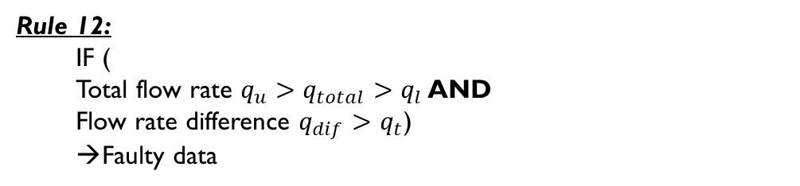
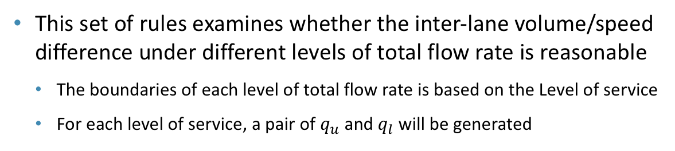
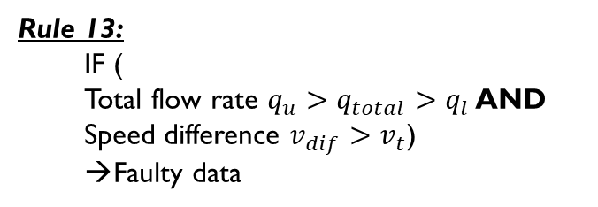
Two Lanes
TWO LANES
This set of rules examines whether the inter-lane volume/speed difference under different levels of total flow rate is reasonable
The boundaries of each level of total flow rate is based on the Level of service
For each level of service, a pair of $q_{u}$ and $q_{l}$ will be generated
Rule 10
Flow rate difference
(between lanes)
Rule 11
Speed difference
(between lanes)
Rule 12:
IF (
Total flow rate $q_{u}>q_{total}>q_{l}$ AND
Flow rate difference $q_{dif}>q_{t}$)
Faulty data
 | Spacing
LOS A | 550 ft
LOS B | 330 ft
LOS C | 220 ft
LOS D | 160 ft
LOS E | Unstable
LOS F | Breakdown flow
Rule 12-14
Relation between total flow rate and:
Flow rate difference
Speed difference
(between lanes)
Average speed
Rule 13:
IF (
Total flow rate $q_{u}>q_{total}>q_{l}$ AND
Speed difference $v_{dif}>v_{t}$)
Faulty data
(North American highway LOS standards as in the Highway Capacity Manual (HCM) and AASHTO Geometric Design of Highways and Streets)

Slide 13
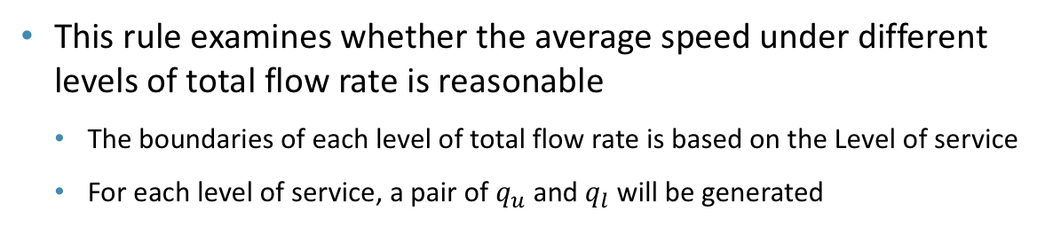
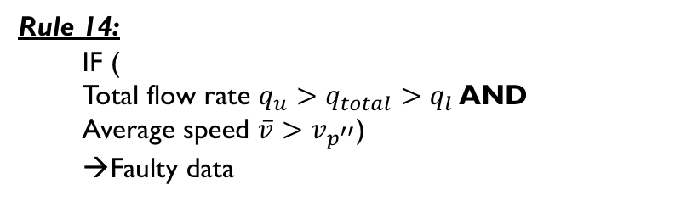
Two Lanes
TWO LANES
This rule examines whether the average speed under different levels of total flow rate is reasonable
The boundaries of each level of total flow rate is based on the Level of service
For each level of service, a pair of $q_{u}$ and $q_{l}$ will be generated
Rule 10
Flow rate difference
(between lanes)
Rule 11
Speed difference
(between lanes)
 | Spacing
LOS A | 550 ft
LOS B | 330 ft
LOS C | 220 ft
LOS D | 160 ft
LOS E | Unstable
LOS F | Breakdown flow
Rule 14:
IF (
Total flow rate $q_{u}>q_{total}>q_{l}$ AND
Average speed $\overline{v}>v_{p^{′′}}$)
Faulty data
Rule 12-14
Relation between total flow rate and:
Flow rate difference
Speed difference
(between lanes)
Average speed
(North American highway LOS standards as in the Highway Capacity Manual (HCM) and AASHTO Geometric Design of Highways and Streets)

Slide 14
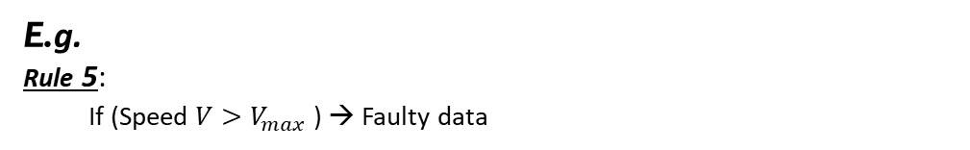
Determine rule threshold
Apply 85th percentile rule
Apply 3 sigma rule (Schaum's Outline of Business Statistics. McGraw Hill Professional. 2003. p. 359)
However, for the two-lane comparison (Rule 10 - Rule 14), mean+ 3*sigma of speed/flow rate difference may have an unreasonably high value (greater than the maximum value).
99.7% quantile would be applied instead for those rules (Would be further explained when introducing the results of case study).
All the thresholds would be generated with similar concept unless particularly specified.
E.g.
Rule 5:
If (Speed $V>V_{max}$ ) → Faulty data
Extract top 15% high speed data for every detector
Using the extracted data to calculate the mean and standard deviation
Applying 3 sigma rule to get the threshold value

Slide 15
Case Study

Slide 16
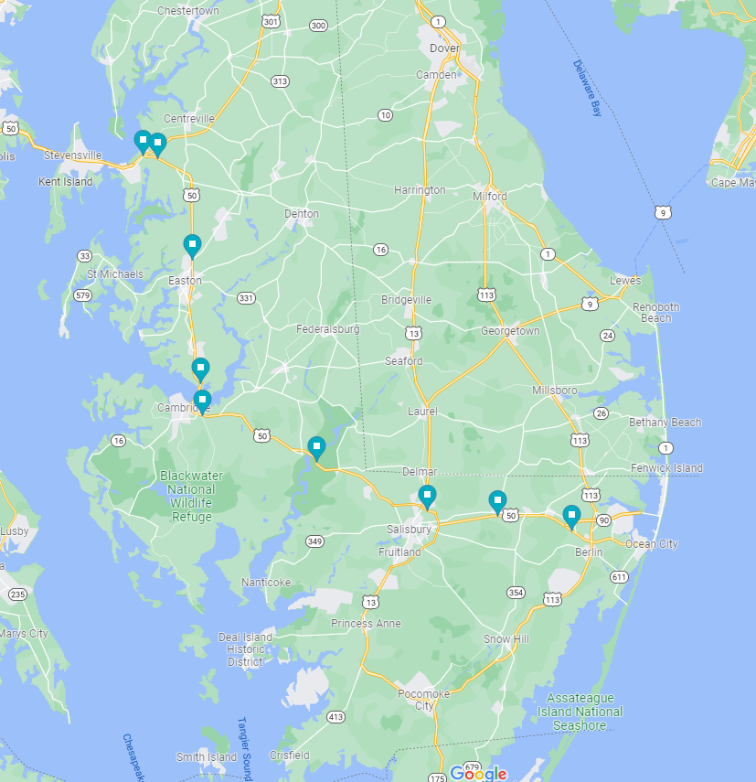
Data introduction
Number of sensors = 9
All selected sensors cover 2-lane segments
Westbound
Time frame: 2018/08/17-2018/09/15
Total number of data = 4,212,852

Slide 17
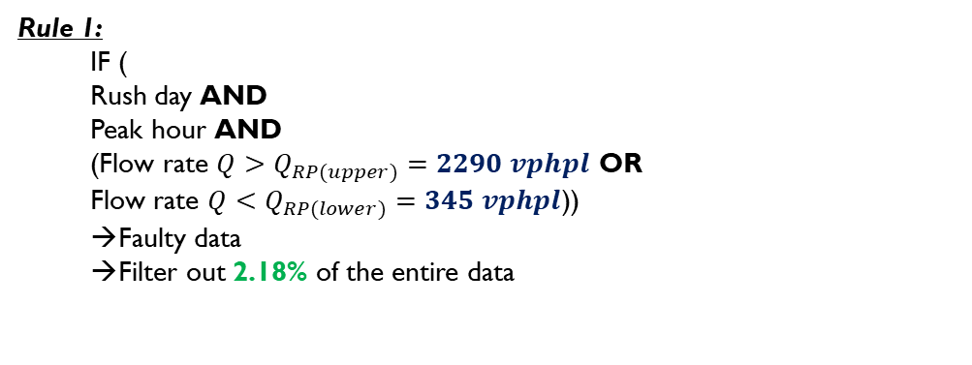
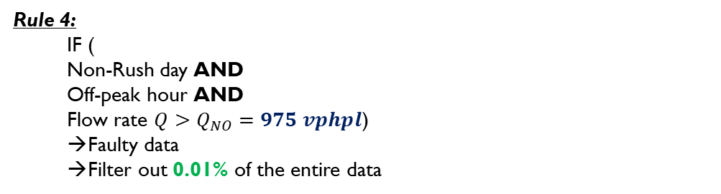
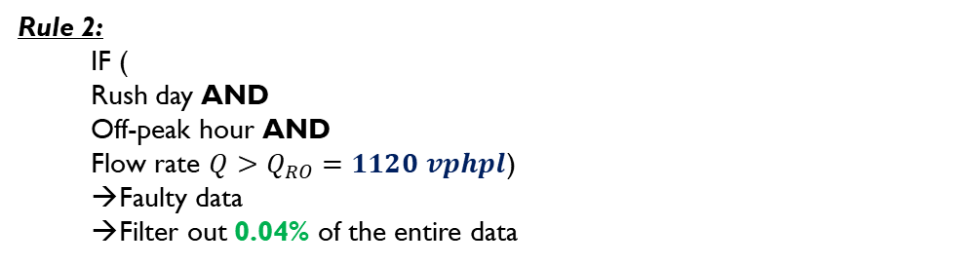
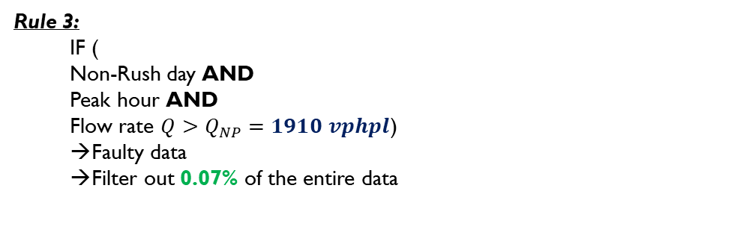
Single Lane-Flow rate
Non-rush Day |  |  |  | Rush Day
Mon | Tue | Wed | Thu | Fri | Sat | Sun
Peak hour: 10 am to 9 pm
Off-peak hour: 9 pm to 10 am
Rule 1:
IF (
Rush day AND
Peak hour AND
(Flow rate $Q>Q_{RP(upper)}=2290 vphpl$ OR
Flow rate $Q<Q_{RP(lower)}=345 vphpl$))
Faulty data
Filter out 2.18% of the entire data
Rule 3:
IF (
Non-Rush day AND
Peak hour AND
Flow rate $Q>Q_{NP}=1910 vphpl$)
Faulty data
Filter out 0.07% of the entire data
Rule 2:
IF (
Rush day AND
Off-peak hour AND
Flow rate $Q>Q_{RO}=1120 vphpl$)
Faulty data
Filter out 0.04% of the entire data
Rule 4:
IF (
Non-Rush day AND
Off-peak hour AND
Flow rate $Q>Q_{NO}=975 vphpl$)
Faulty data
Filter out 0.01% of the entire data

Slide 18
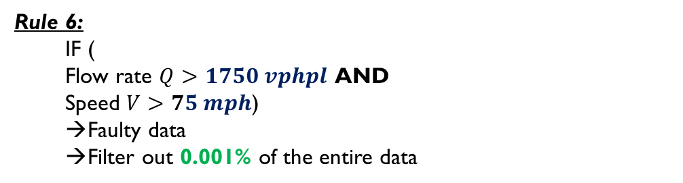
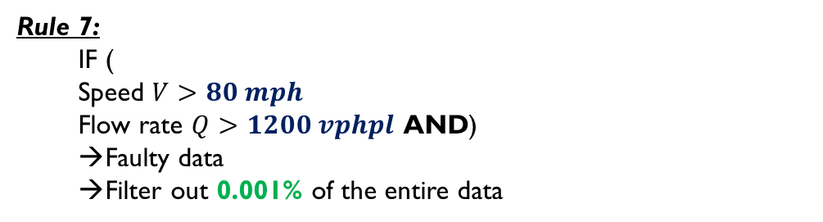
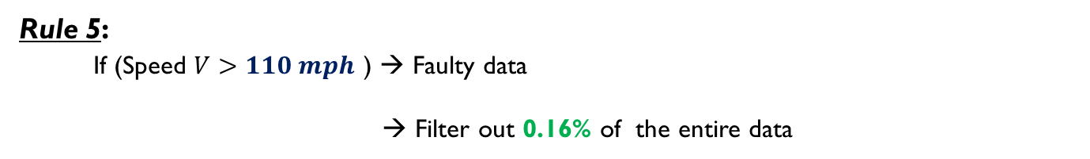
Single Lane-Speed
Rule 5:
If (Speed $V>110 mph$ ) → Faulty data
→ Filter out 0.16% of the entire data
Single Lane-Flow rate + Speed
Rule 6:
IF (
Flow rate $Q>1750 vphpl$ AND
Speed $V>75 mph$)
Faulty data
Filter out 0.001% of the entire data
Extract top 15% high flow rate for every detector
Using the extracted data to calculate the mean and standard deviation for speed and the mean for flow rate
Applying 3 sigma rule to get the threshold value for speed
Rule 7:
IF (
Speed $V>80 mph$
Flow rate $Q>1200 vphpl$ AND)
Faulty data
Filter out 0.001% of the entire data

Slide 19
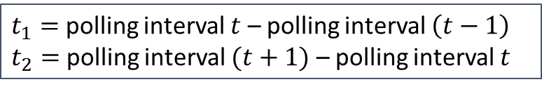
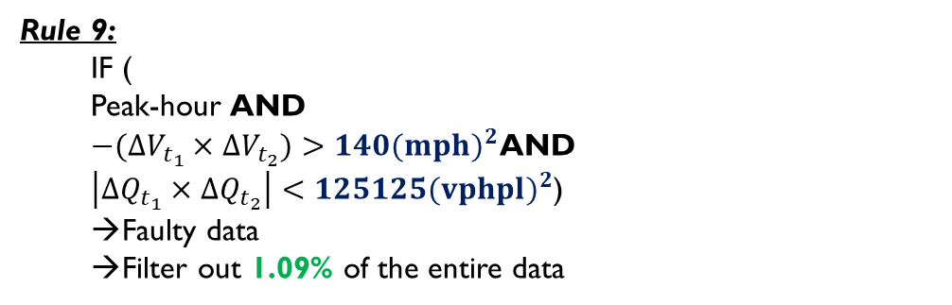
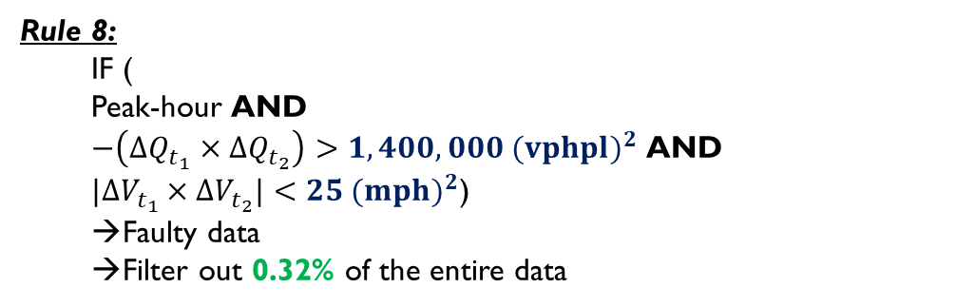
Single Lane-Time series relation
Rule 8:
IF (
Peak-hour AND
$−\left(∆Q_{t_{1}}×{∆Q}_{t_{2}}\right)>1,400,000 {(vphpl)}^{2}$ AND
${|∆V}_{t_{1}}×{∆V}_{t_{2}}|<25 {(mph)}^{2}$)
Faulty data
Filter out 0.32% of the entire data
Extract top 15% high product of flow rate difference for every detector
Using the extracted data to calculate the mean and standard deviation for the product of speed difference and the mean of the product of flow rate difference
Applying 3 sigma rule to get the threshold value for product of the speed difference
Rule 9:
IF (
Peak-hour AND
${−(∆V}_{t_{1}}×{∆V}_{t_{2}})>140{(mph)}^{2}$AND
$\left|∆Q_{t_{1}}×{∆Q}_{t_{2}}\right|<125125{(vphpl)}^{2}$)
Faulty data
Filter out 1.09% of the entire data
$t_{1}=$ polling interval $t$ – polling interval $\left(t−1\right)$
$t_{2}=$ polling interval $(t+1)$ – polling interval $t$
Notes:
Total number of data =4212852

Slide 20
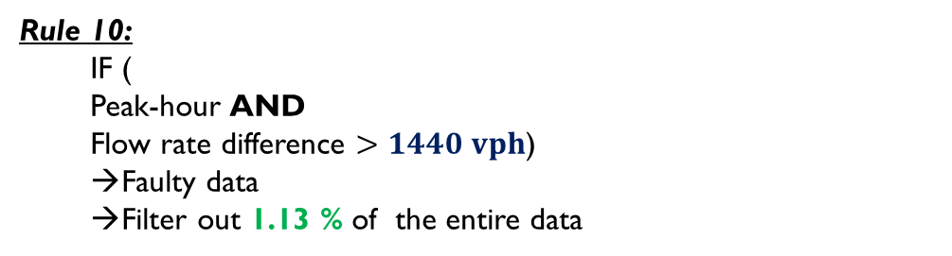
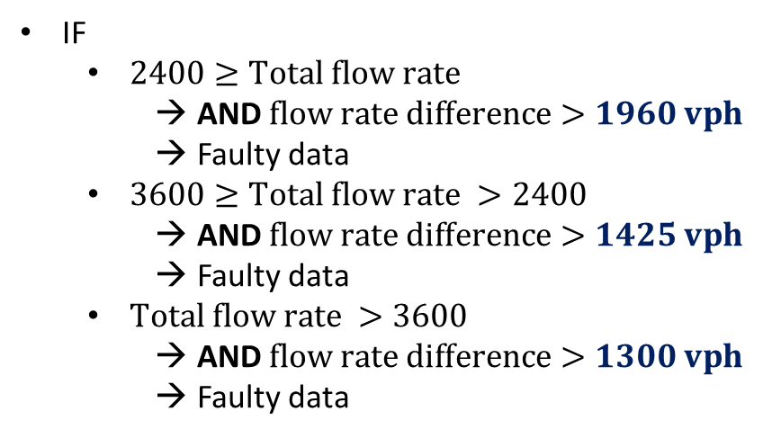
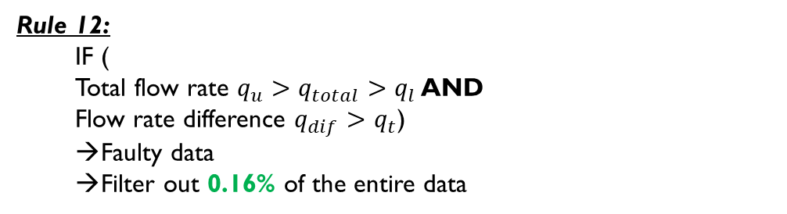
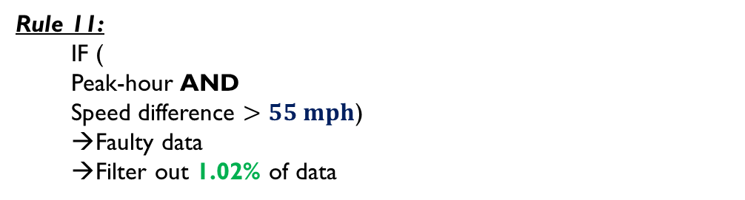
For each different total flow rate interval, extracting the data with top 15% flow rate difference from each sensor
Calculating each interval’s flow rate’s 99.7% quantile from the extracted data
Using the value of 99.7% quantile as the threshold
Two Lanes
Assume that the allowed difference should be smaller when total flow rate is high and the data supports this hypothesis.
Rule 10:
IF (
Peak-hour AND
Flow rate difference $>1440 vph$)
Faulty data
Filter out 1.13 % of the entire data
Rule 12:
IF (
Total flow rate $q_{u}>q_{total}>q_{l}$ AND
Flow rate difference $q_{dif}>q_{t}$)
Faulty data
Filter out 0.16% of the entire data
Extracting the data with top 15% flow rate difference from each sensor
Calculating the flow rate difference’s 99.7% quantile from the extracted data
Using the value of 99.7% quantile as the threshold
IF
$2400≥Total flow rate$
AND $flow rate difference>1960 vph$
Faulty data
$3600≥Total flow rate >2400$
AND $flow rate difference>1425 vph$
Faulty data
$Total flow rate >3600$
AND $flow rate difference>1300 vph$
Faulty data
Rule 11:
IF (
Peak-hour AND
Speed difference $>55 mph$)
Faulty data
Filter out 1.02% of data
Notes:
https://safety.fhwa.dot.gov/geometric/pubs/mitigationstrategies/chapter3/3_designspeed.cfm

Slide 21
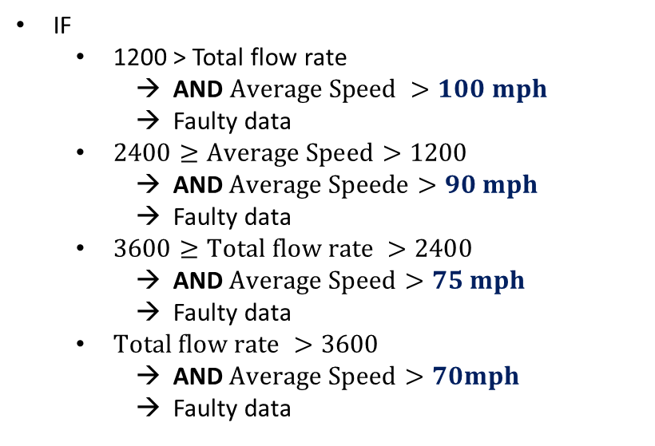
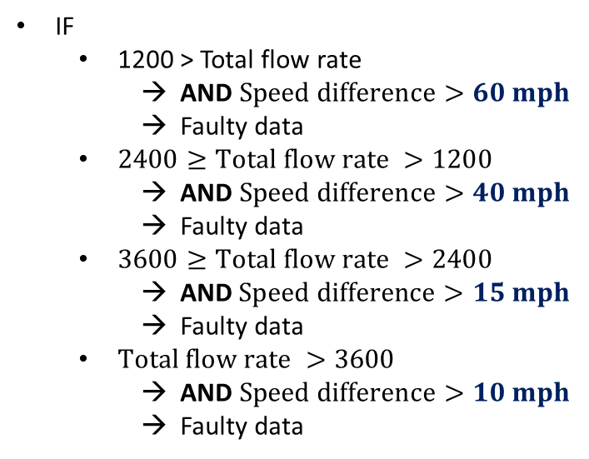
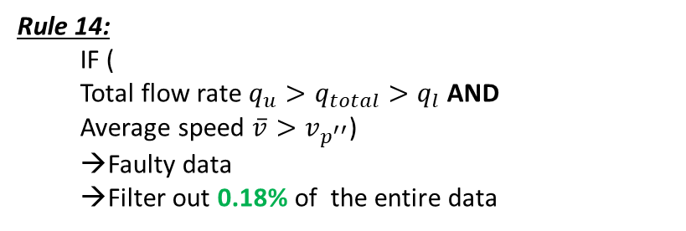

Two Lanes
Rule 13:
IF (
Total flow rate $q_{u}>q_{total}>q_{l}$ AND
Speed difference $v_{dif}>v_{t}$)
Faulty data
Filter out 0.99% of the entire data
Rule 14:
IF (
Total flow rate $q_{u}>q_{total}>q_{l}$ AND
Average speed $\overline{v}>v_{p^{′′}}$)
Faulty data
Filter out 0.18% of the entire data
IF
1200 > Total flow rate
AND $Speed difference>60 mph$
Faulty data
$2400≥Total flow rate >1200$
AND $Speed difference>40 mph$
Faulty data
$3600≥Total flow rate >2400$
AND$Speed difference>15 mph$
Faulty data
$Total flow rate >3600$
AND $Speed difference>10 mph$
Faulty data
IF
1200 > Total flow rate
AND $Average Speed >100 mph$
Faulty data
$2400≥Average Speed>1200$
AND$Average Speede>90 mph$
Faulty data
$3600≥Total flow rate >2400$
AND$Average Speed>75 mph$
Faulty data
$Total flow rate >3600$
AND$Average Speed>70mph$
Faulty data

Slide 22
Screening results
ONE LANE
 | Static
Screening rate | Rule 1 | Rule 2 | Rule 3 | Rule 4 | Rule 5 | Rule 6 | Rule 7
 | 2.18% | 0.04% | 0.07% | 0.01% | 0.16% | 0.001% | 0.001%
 | Time series
Screening rate | Rule 8 | Rule 9
 | 0.32% | 1.09%
TWO LANE
Screening rate | Rule 10 | Rule 11 | Rule 12 | Rule 13 | Rule14
 | 1.13% | 1.02% | 0.16% | 0.99% | 0.18%
Notes:
Total number of data =4212852

